Slide 1
Smart Lightweight Medical Query System (SLiMQ)
Design a smart medical response system to aid doctors
The solution should be lightweight enough to run on off the shelf machines/edge devices
Requirements:
A python/Jupyter based environment (you can create a pure C++ application as well)
Pre-trained LLM for answer completion
A mechanism to store and access the local shared data
Deliverables:
A Jupyter Notebook/Standalone app containing the solution
User : What are tips for managing my bipolar disorder? System : Along with seeing your doctor and therapist and taking your medicines, simple daily habits can make a difference. Start with these strategies. Pay attention to your sleep. This is especially important for people with bipolar disorder... (178 words truncated) Eat well. There’s no specific diet... (29 words truncated) Focus on the basics: Favor fruits, vegetables, lean protein, and whole grains. And cut down on fat, salt, and sugar. Tame stress. (81 words truncated) You can also listen to music or spend time with positive people who are good company. (73 words truncated) Limit caffeine. It can keep you up at night and possibly affect your mood. (47 words truncated) Avoid alcohol and drugs. They can affect how your medications work.

Slide 2
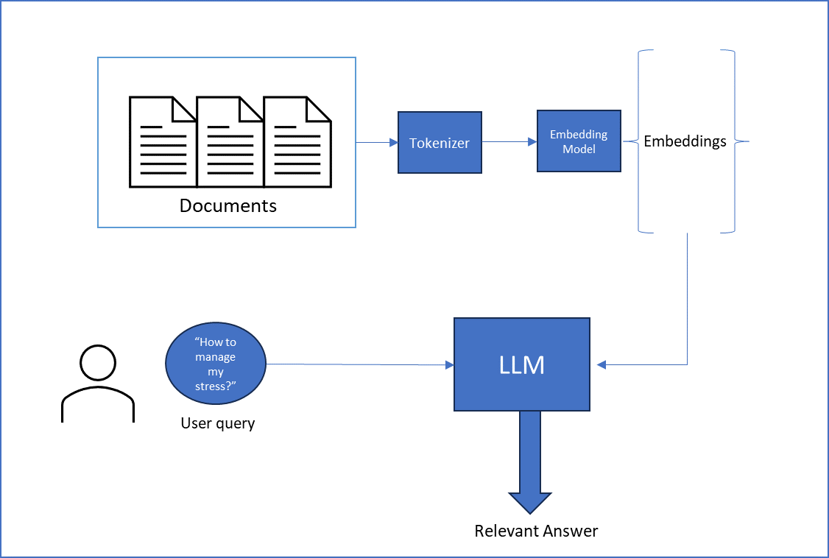
Problem workflow
LLMs have knowledge cutoff or not trained for specific use cases or private data
Use the external documents (MASHQA) to refine your result
Example:
Query, "What are tips for managing my bipolar disorder?”
Vanilla LLM: “Using a psychiatric medication can help you manage your mood and anxiety”
Using docs: “Establish routines. Regular sleep, eating, and activity appear to help people with bipolar disorder”
Further detailed challenges are shared in the problem statement

